Slide 2
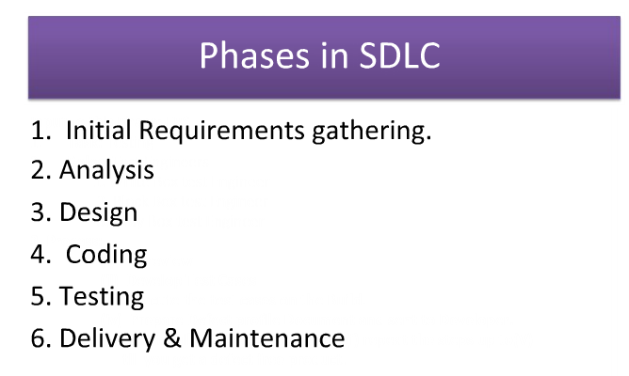
From: http://www.wiziq.com/tutorial/85154-An-Introduction-to-Software-Engineering

Slide 3
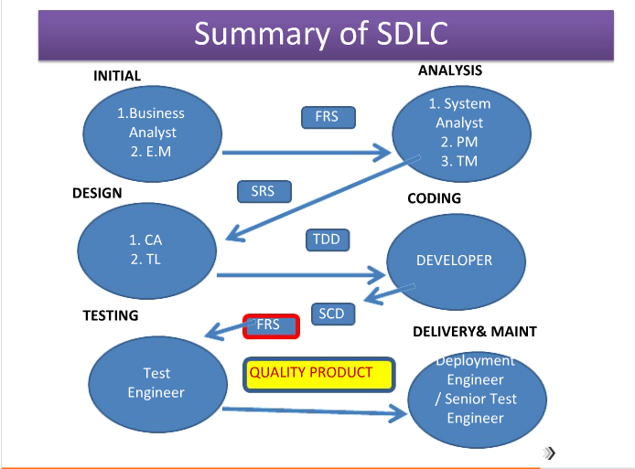
From: http://www.wiziq.com/tutorial/85154-An-Introduction-to-Software-Engineering

Slide 4
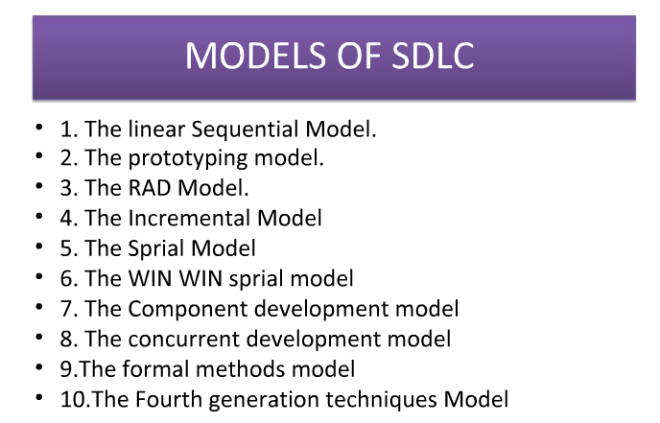
From: http://www.wiziq.com/tutorial/85154-An-Introduction-to-Software-Engineering

Slide 5
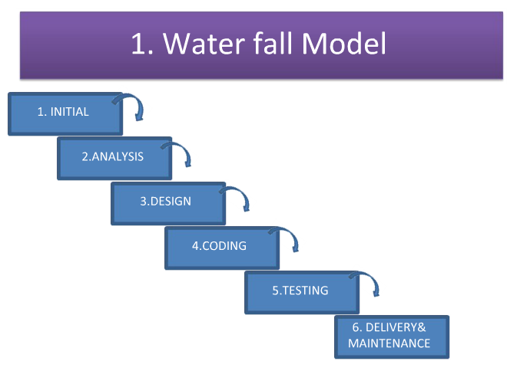
From: http://www.wiziq.com/tutorial/85154-An-Introduction-to-Software-Engineering

Slide 6
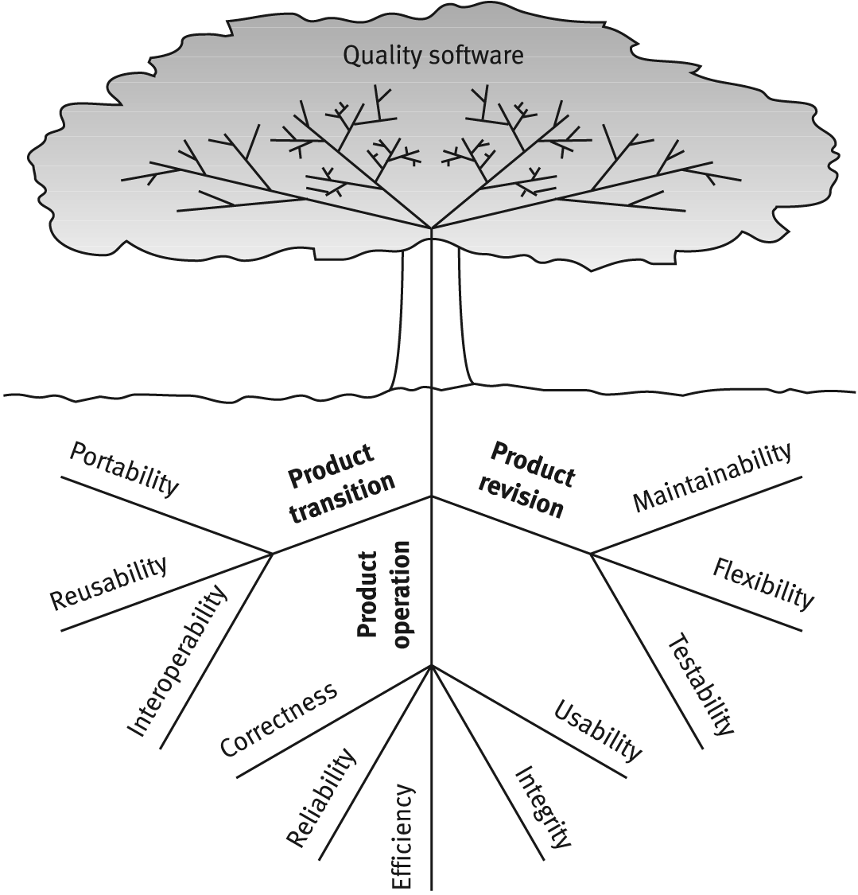
McCall’s Software quality factors
Verifiability?
Safety?

Slide 7
Presentations next time
10 minutes talk time - with some slides ( to be turned in on blackboard)
Your audience are mainly the students in the course – not me
hopefully the presentations are informative, stimulating, and engaging and cause questions to be asked by the audience
include references in the slides - so that I can find your sources
see presentation rubric on blackboard for evaluation criteria

Slide 8
Presentation topics
SDLC - details of i)tasks, ii) roles, iii) process and iv) outcome for each step in the SDLC
SCRUM
Software quality assurance – A practical view
Important SDLC methods – compare and contrast (include at least iterative & incremental, spiral, V-shaped, (rapid) prototyping)

